Slide 1
Business Analytics Presentation!
By: Matthew Hiebler. Mostafa Eid, Rahul Roy, Manish & Mayu.

Slide 2
Organisational and Project Background
The purpose of the applied project was in relation to concerns regarding the wild life situation and the concerns of the 3 personas.
The concerns surrounded International Trade in Endangered Species, which also discussed how some markets/ countries are contributing to the decline/extinction of species.

Slide 3
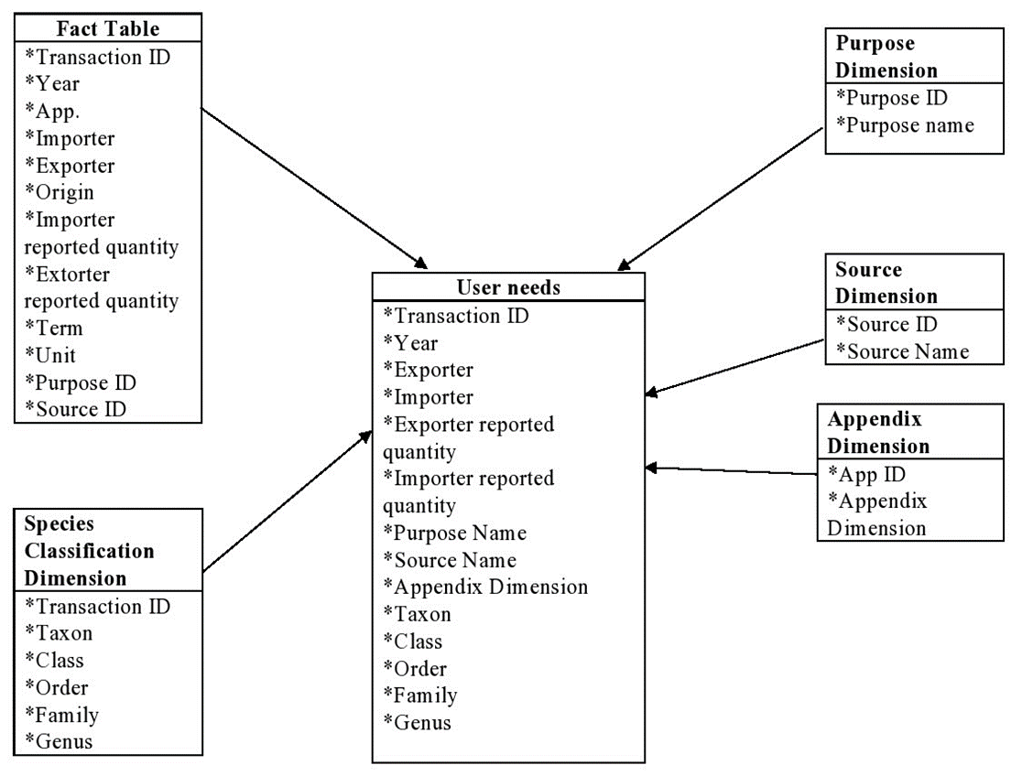
Multidimensional Model.
Helps categorize data as being either facts with associated numerical measures
Multidimensional outlook provides the ability create links between different dimensions

Slide 4
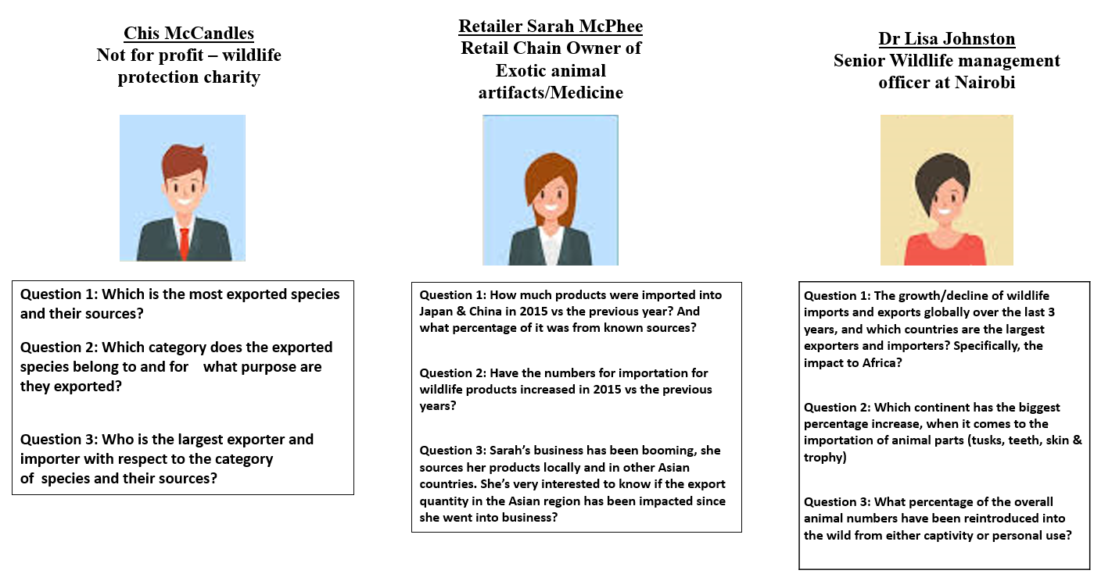
Personas!

Slide 5
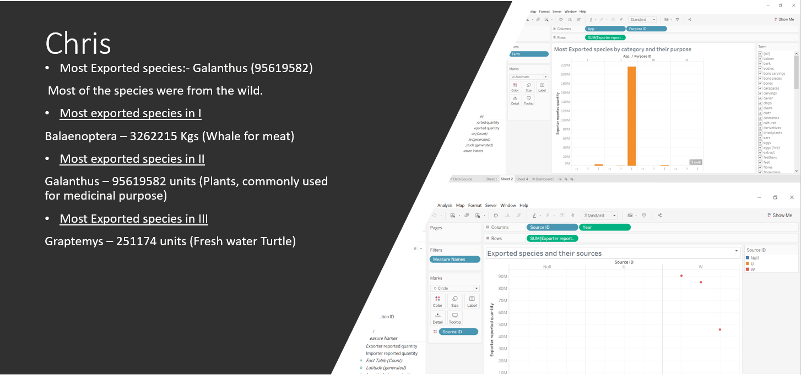
Chris!

Slide 6
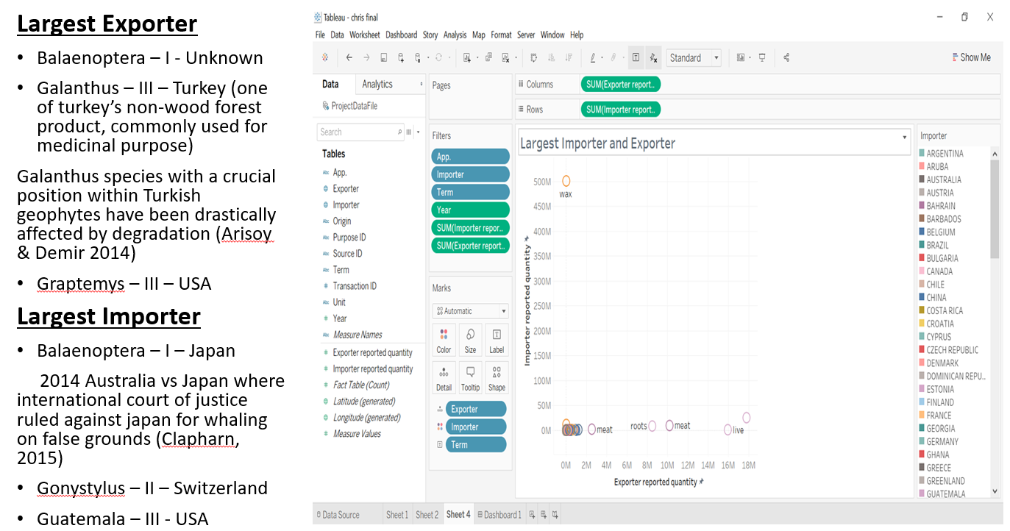
Chris

Slide 7
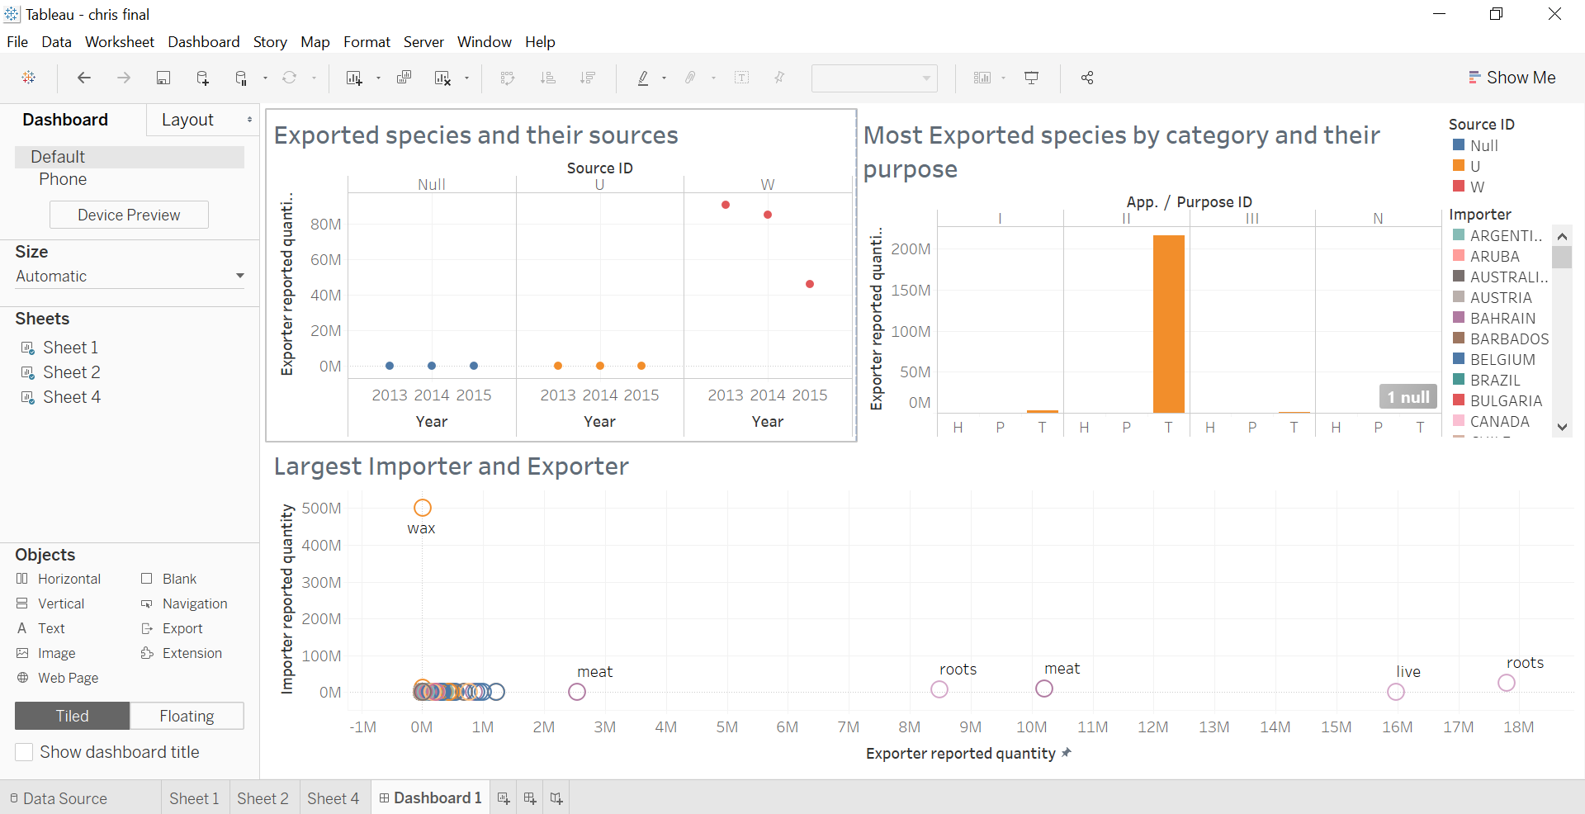
Chris Dashboard

Slide 8
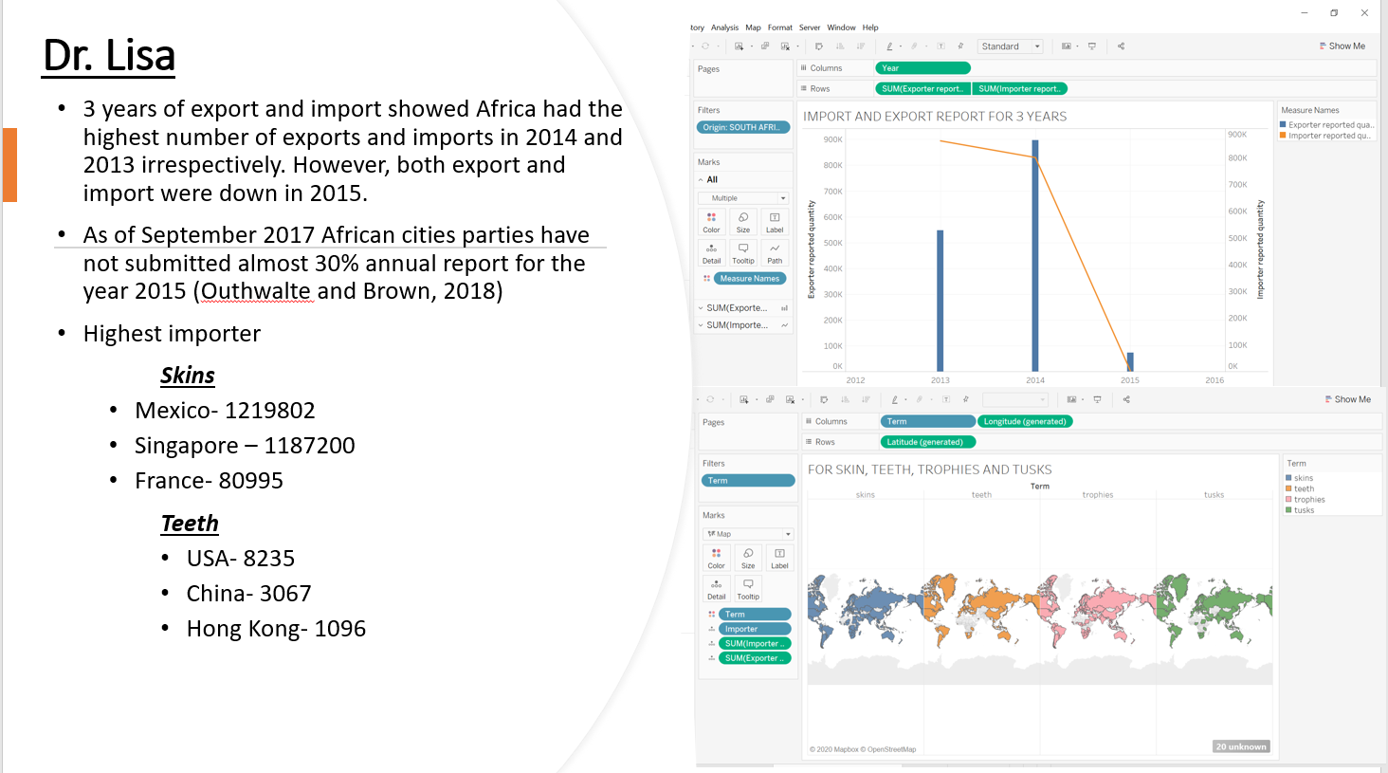
Dr Lisa!

Slide 9
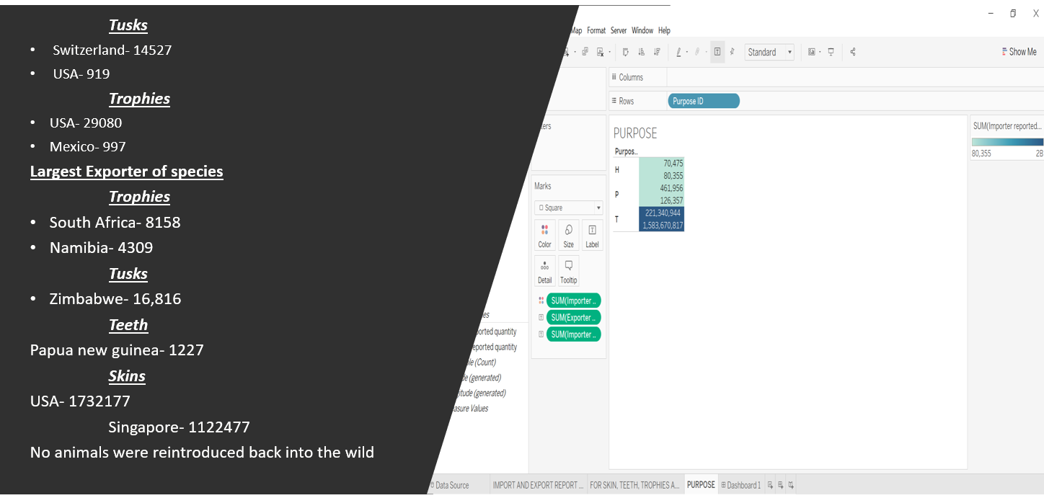
Dr Lisa.

Slide 10
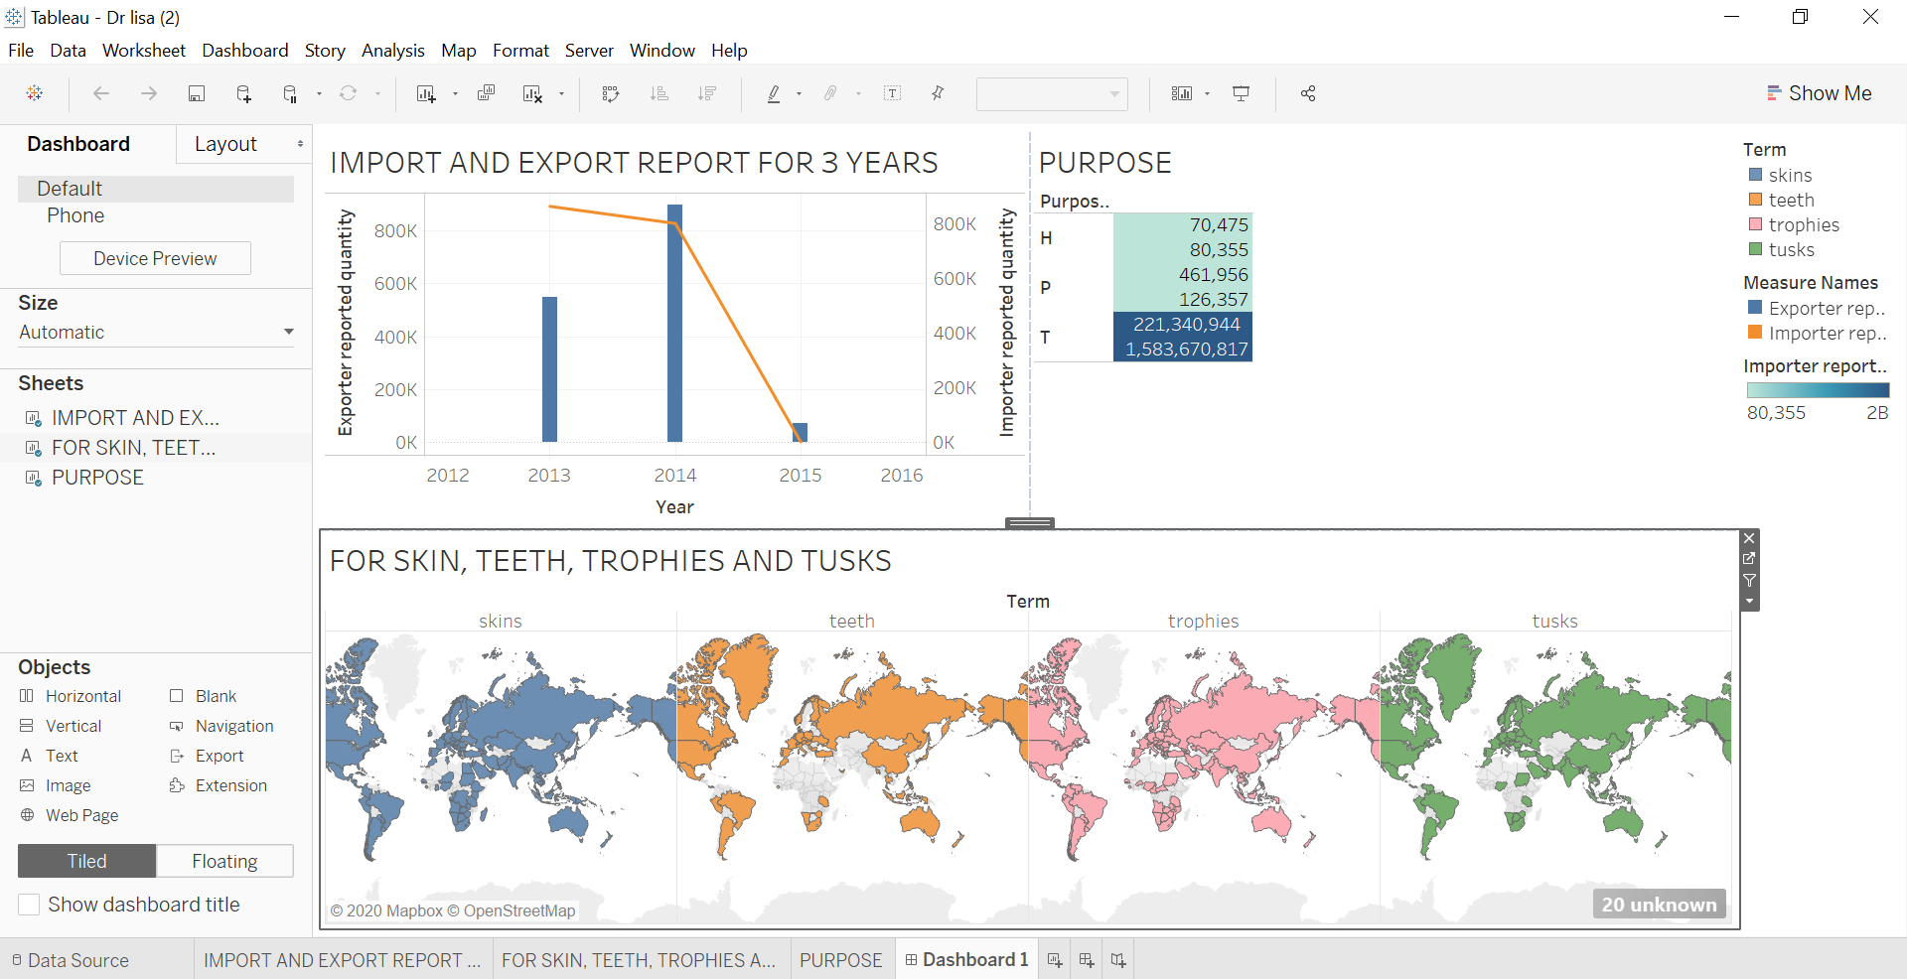
Dr Lisa Dashboard

Slide 11
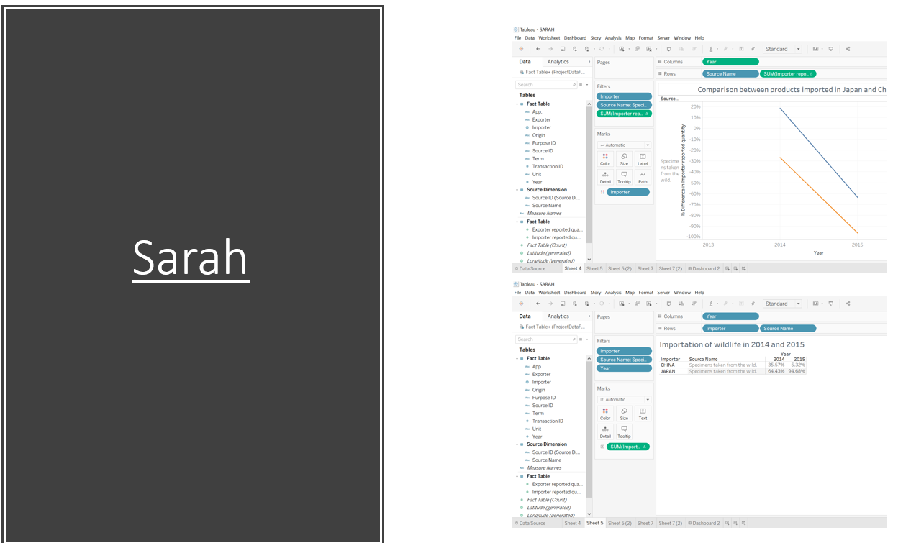
Sarah

Slide 12
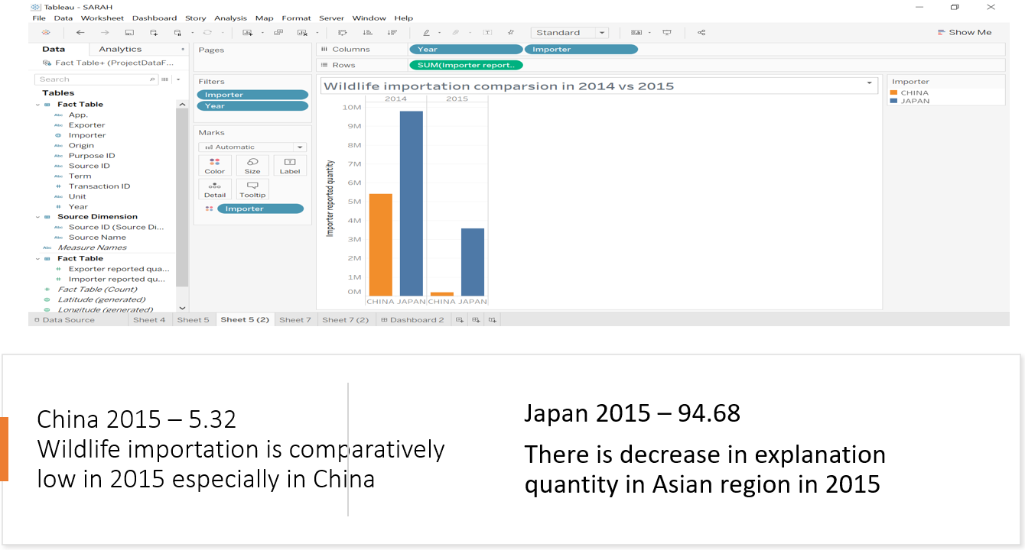
Sarah Tableau.

Slide 13
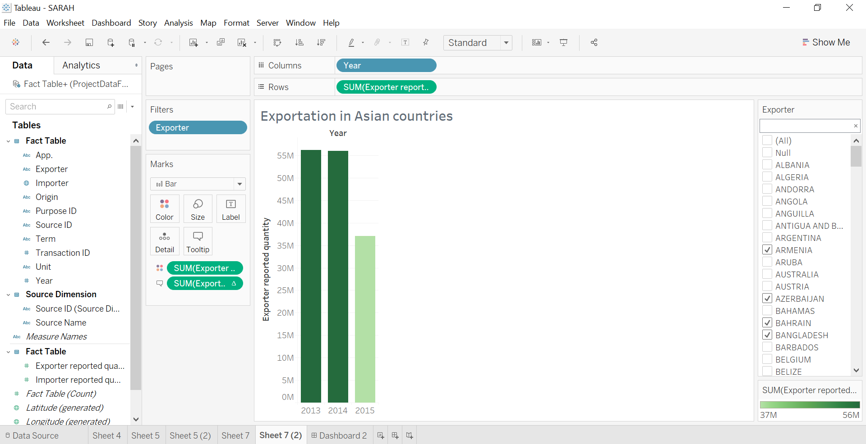
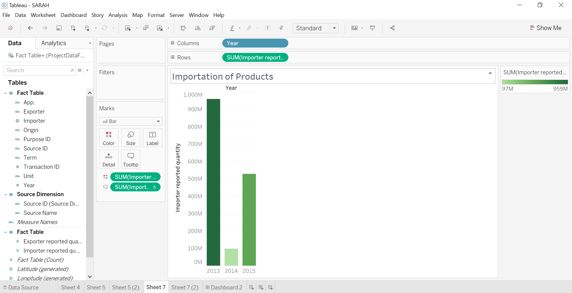
Sarah Tableau.

Slide 14
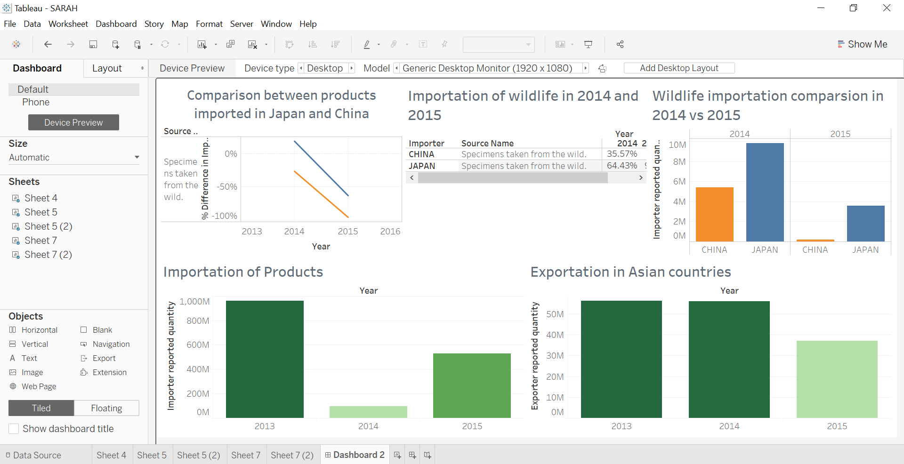
Dashboard for Sarah

Slide 15
Lessons Learnt!
We learnt how to create various personas.
We learnt how to use Tableau in order to utilise data to reveal various key insights.

Slide 16
Conclusion.
We have learnt to work as a team when creating presonas and also learnt how to use Tableau software to create relevant personas.
Thank you for reviewing our presentation!

Slide 17
References
Tableau Data file. Provided by Western Sydney University.

Slide 18
Questions & Answers
Any questions so that we can provide further information to our findings?

